Slide 1
Multimodal Biometric Systems
19ucc023 – Mohit Akhouri
19uec023 – Hitesh Goyal
19uec113 – Agraj Garg
19ucc043 – Aditya Pandey

Slide 2

What are Biometric Systems ?
Biometric Systems use personal characteristics of a person to authenticate or identify a person.
Some of the Biometric characteristics that can be used are as follows :
Face
Fingerprint
Hand Geometry
Palm Print
Iris
Voice
Signature
Keystroke dynamics

Slide 3
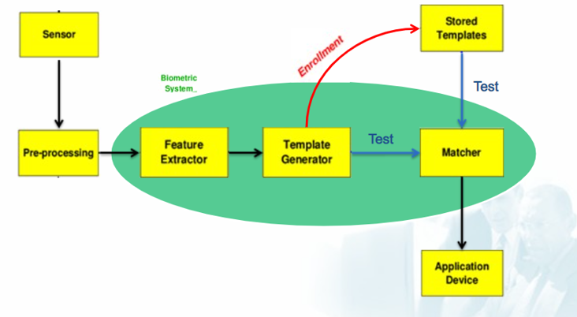
Working of a Unimodal Biometric System

Slide 4
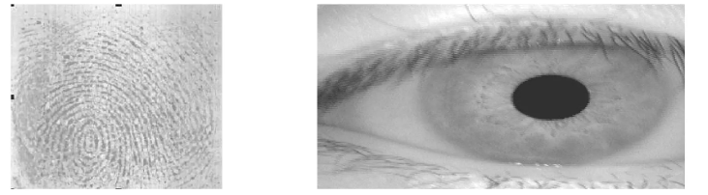
Why Multimodal Biometrics ?
Unimodal Biometric systems perform person recognition based on a single source of biometric information.
Unimodal Biometric systems are affected by the following problems :
Noisy Sensor Data – Noise can be present in the biometric data which is acquired due to defective or improperly maintained sensors.

Slide 5
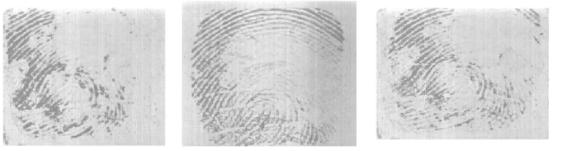
Why Multimodal Biometrics contd….
Non-Universality – A Biometric trait is said to be universal if every individual in the target population is able to present biometric trait for recognition. NIST reported 2% people cannot enroll using finger print.
Lack of Individuality – Features extracted from biometric characteristics of different individuals can be quite similar. A small proportion of population can have nearly identical facial appearance due to genetic factors.

Slide 6
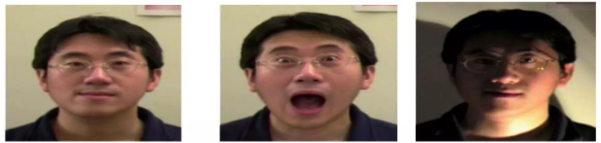
Why Multimodal Biometrics contd….
Lack of invariant representation – The biometric data acquired from user during verification may not be identical to data used for generating user’s template during enrollment.
Spoofing – Unimodal Biometrics is vulnerable to spoofing where the biometric data can be imitated or forged.

Slide 7
Literature Survey
“Multimodal Biometric System Based on Fingerprint, Iris and Face Recognition” By Smith et al.
Proposes a multimodal biometric system that combines fingerprint, iris and face recognition modalities.
The paper focused on developing efficient feature extraction techniques for each modality and explore fusion strategies to integrate information efficiently.
The authors conducted experiments using a large dataset and achieved superior recognition accuracy compared to unimodal biometric systems.
The multimodal biometric system designed has enhanced security and robustness against spoofing attacks.

Slide 8
Literature Survey contd….
“A Novel Approach for Multimodal Biometric Fusion using Deep Learning” By Lee et al.
This paper presents a novel approach for multimodal biometric fusion using deep learning techniques.
It presents a deep neural network architecture which combines features extracted from fingerprint, iris and face modalities.
Deep Learning improved the accuracy and reliability of multimodal biometric systems.
These systems can be used where accurate identification is crucial.

Slide 9
Literature Survey contd….
“Secure Multimodal Biometric System based on Fingerprint and Palmprint Fusion” By Chen et al.
This research paper focused on development of secure multimodal biometric system using fingerprint and palmprint fusion.
The proposed system combines features extracted from fingerprint and palmprint modalities using a fusion algorithm based on score-level and feature-level fusion techniques.
The proposed system demonstrates enhanced accuracy and resilience against spoofing attacks compared to unimodal systems.
These systems can be used in access control and identity verification.

Slide 10
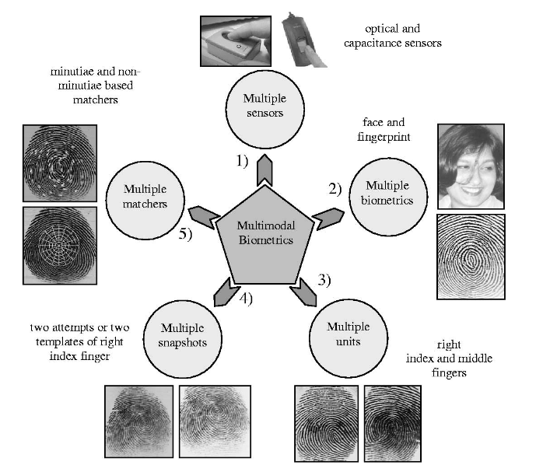
Scenarios in Multimodal Biometric Systems

Slide 11
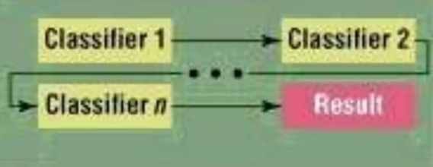
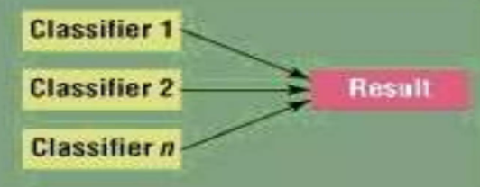
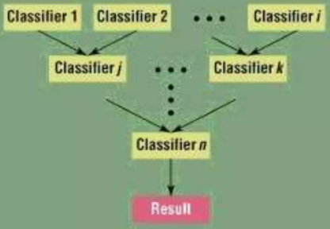
Modes of Multimodal Biometric System
A Multimodal Biometric System can operate in one of 3 different modes :
Serial – The Output of one biometric trait is used to narrow down the possible identities before next trait is used.
Parallel – Information from multiple traits is used simultaneously to perform recognition,
Hierarchical – Individual classifiers are combined in tree-like structure.

Slide 12
Fusion in Multimodal Biometric Systems
Multimodal Biometric Systems integrate information from multiple biometric indicators.
Fusion is divided into three parts which are as follows :
Fusion at the feature extraction level
Fusion at the matching score ( confidence or rank ) level
Fusion at the decision ( abstract label ) level

Slide 13
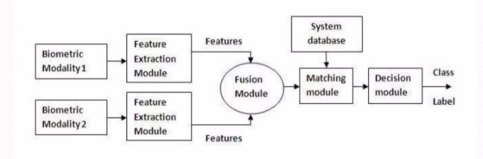
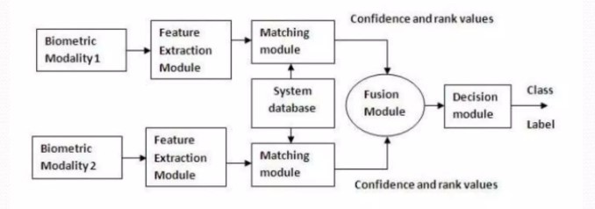
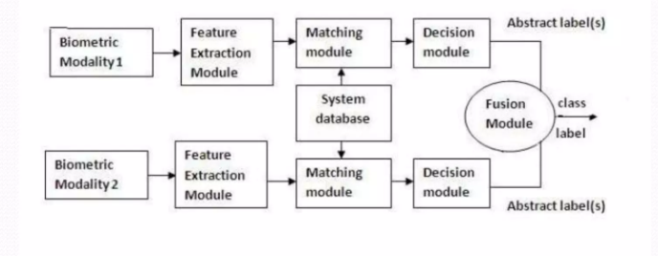
Types of Fusion
Feature Level Fusion – Combining feature vectors. When features of different modalities are compatible with each other, then more accuracy.
Matching Score Level Fusion – Individual matching score of different feature vectors is found and fused to make classification.
Decision Level Fusion – Each biometric modality makes it own recognition decision based on its feature vector.

Slide 14
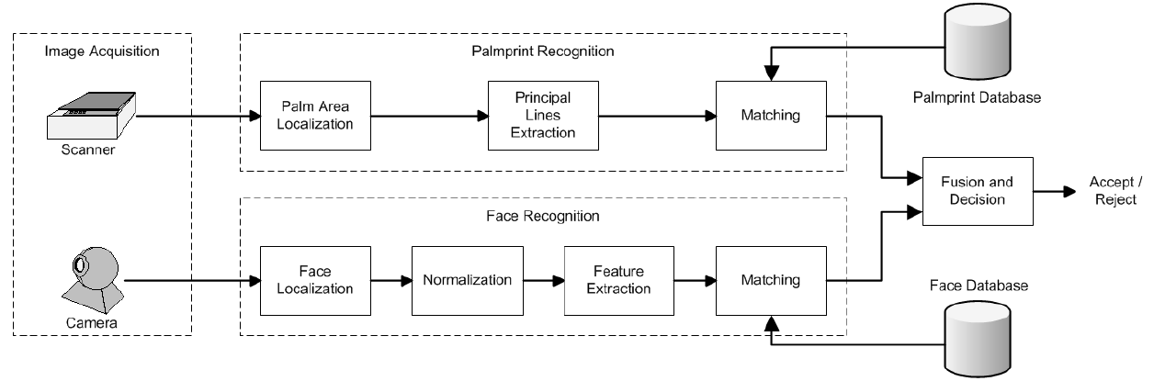
System Designed
We can make a multimodal biometric system using these two modalities :
Palmprint ( Haptic/Touch Modality )
Facial Features ( Visual Modality )
The Block Diagram for the system designed will be :

Slide 15
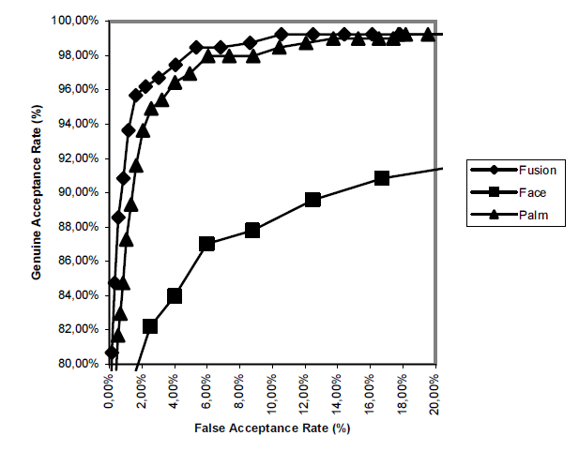
Results and Findings
The findings from the graph are as follows :
Verification based on palmprint easily outperforms the verification based on the face.
Fusion of palmprint and facial features improves the verification score.

Slide 16
Pros and Cons of Multimodal Biometrics
Pros :
More Secure, spoofing is hard
Accuracy is more
Reduce Failure to enroll rate (FTE)
Reduce False accept rate (FAR)
Reduce False reject rate (FRR)
Cons :
High Cost
Scalability
Increase System Complexity
Sensor Limitations are there
Ethical Considerations

Slide 17
Conclusion and Future Work
In conclusion, multimodal biometric systems enhances accuracy and reliability compared to their unimodal counterparts.
However, there are still some challenges which need to be addressed which are :
Performance Improvement – We can develop more advanced fusion algorithms that reduce false acceptance and false rejection rates and are more accurate.
Usability and User Experience – Efforts can be made to address user concerns and improve the usability of multimodal biometric systems.
Scalability and Efficiency – We can conduct research to develop scalable and efficient multimodal biometric systems to handle large user populations.
Ethical and Privacy Considerations – Future work in multimodal biometrics should emphasize on ethical considerations and privacy protection.

Slide 18
References
S. Ribaric, Kristina Kis, “A biometric verification system based on the fusion of palmprint and facial features”, October 2005
A. Khattab, “Multi-modal Biometric System”, October 23, 2016
Priyanka S. Patil, A. Abhyankar, “Multimodal Biometric Identification System Based on Iris & Fingerprint”, 2013
Rajendra Prasad Nayak, “Seminar on Multimodal Biometric Systems”, NIT Rourkela
Blaise Craig, “Multimodal Biometric Security”, 2017
https://www.innovatrics.com/glossary/biometric-system/

Slide 19
THANK YOU

